Slide 1


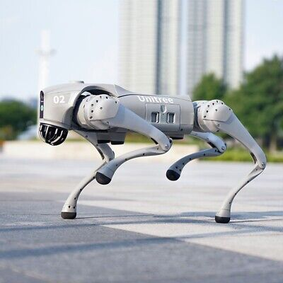
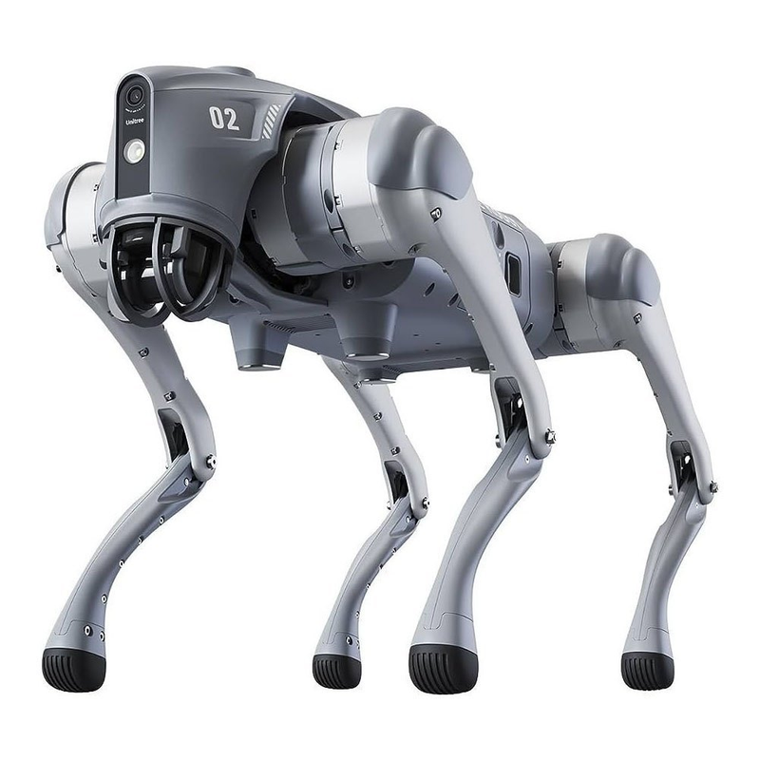

QUAR-VLA: VISION-LANGUAGE-ACTION MODEL FOR
QUADRUPED ROBOTS
Abdalrahim Sawalha
&
Jihad Janazrah
01

Slide 2

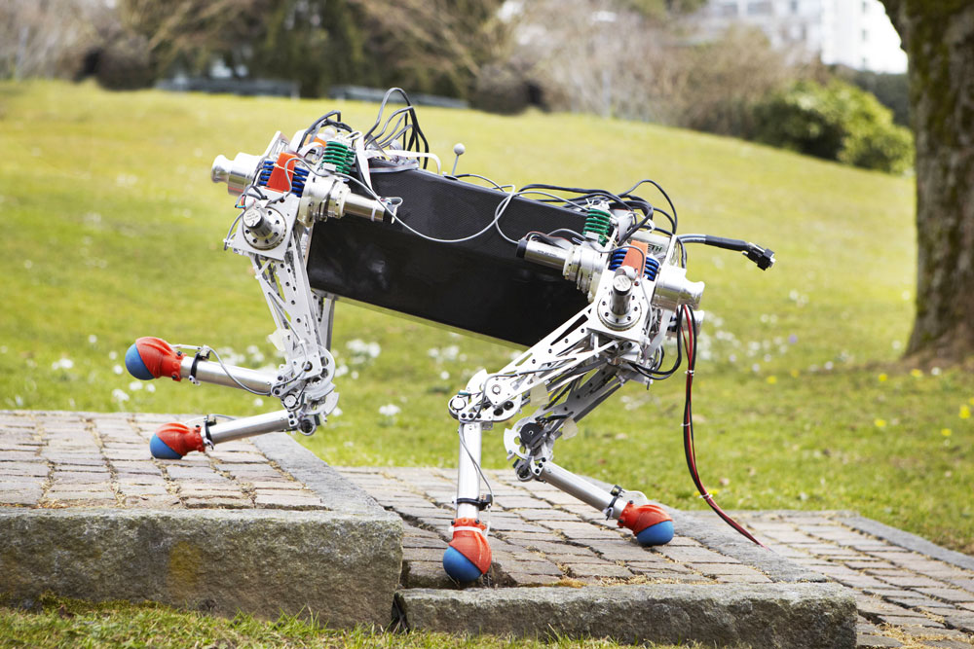
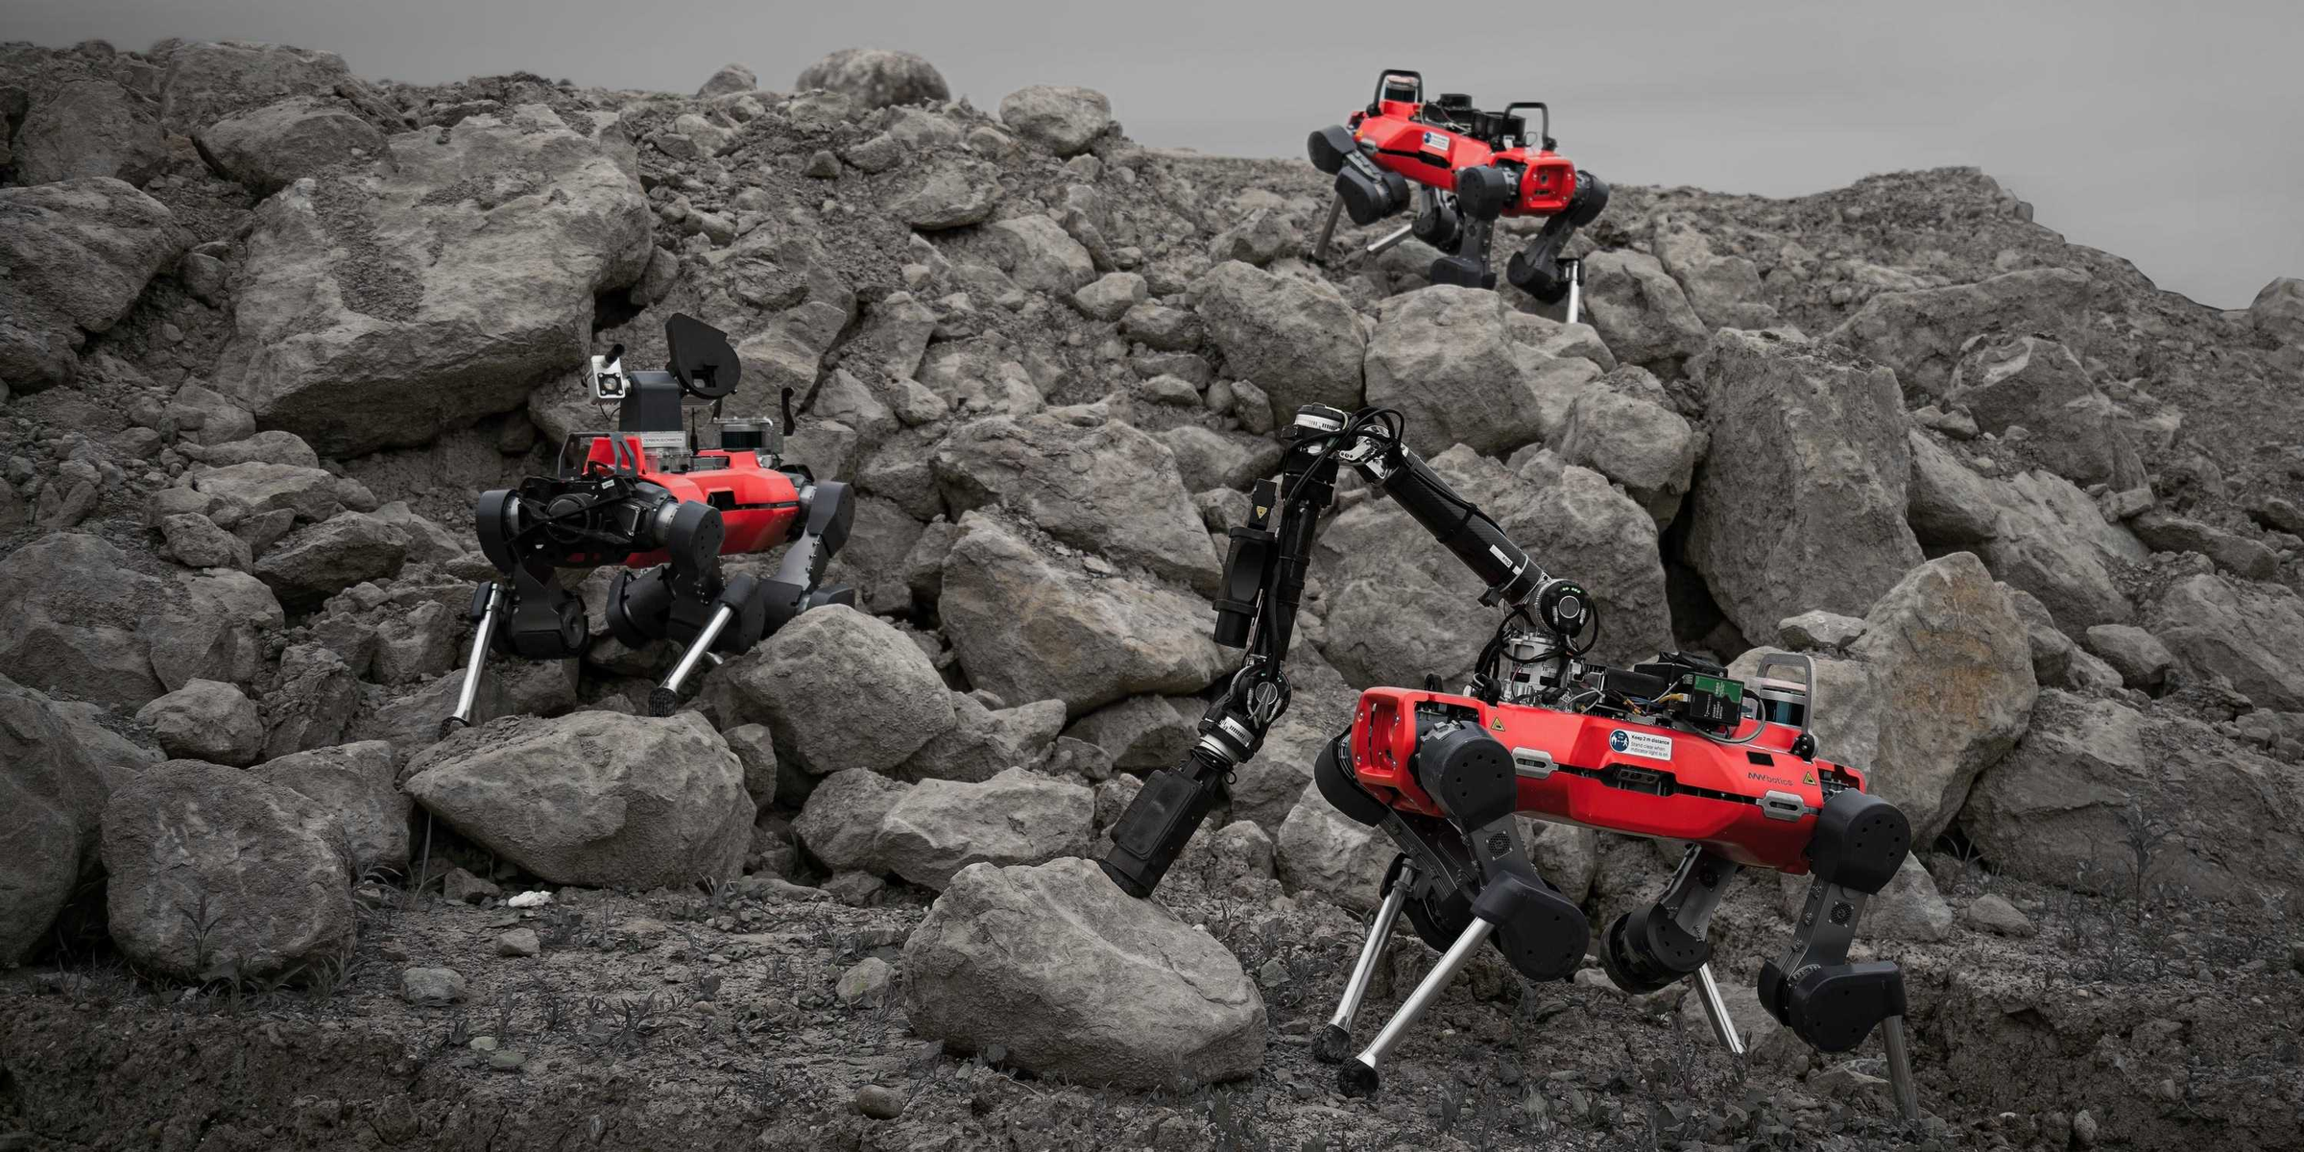
INTRODUCTION
Quadruped robots are very good at moving through rough and complex terrain. This makes them great for tasks like autonomous navigation and object handling. They are now being used more often in difficult missions, such as search-and-rescue or delivery.
Traditional control methods treat perception, planning, and decision-making as separate steps. While this makes the system easier to design, it limits how well the robot can combine information from different sources. As a result, the robot may struggle to perform smooth, coordinated actions.
To solve this, we introduce the QUAR-VLA approach. It combines visual input and natural language instructions to create actions the robot can carry out. This integrated Vision-Language-Action (VLA) system helps improve the robot’s intelligence by allowing end-to-end understanding and control.
02

Slide 3
PARADIGMS COMPARED
Vision-Action (QUAR-VA): Uses an observation image and a goal image to generate actions (highlevel planning) .
Lacks explicit language instructions, relying only on visual goals.
Language-Action (QUAR-LA): Uses a language instruction (e.g. “trot twice as fast as others”) without visual input .
Lacks environment perception, so autonomy is limited.
Vision-Language-Action (QUART-VLA): Combines both modalities: takes first-person camera images and natural language instructions as inputs . This enables solving diverse tasks autonomously by grounding language in vision .
WWW.REALLYGREATSITE.COM
03

Slide 4
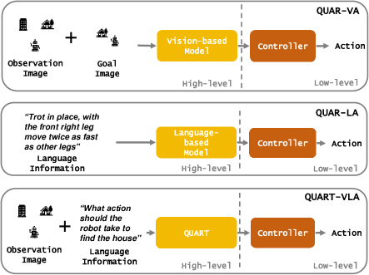

Slide 5
ROBOT PLATFORM
WR-2 Quadruped: The experimental platform is a small quadruped robot with 12 actuated joints (3 per leg). It stands ~25 cm tall with a 40 cm body length, making it compact for lab use.
Actuators & Gaits: Leg joints are driven by electric motors (via a low-level MPC or learned policy) to realize various gaits (trotting, bounding, crawling, etc.). The high-level commands include selecting gait patterns and speeds.
Sensors: A front-mounted Intel RealSense D435 provides RGB-D (color + depth) images for perception. Proprioceptive sensors (joint encoders, IMU) record robot state. During data collection, the robot records camera images and depth in steps of 10 time-steps.
Control Architecture: A hierarchical control scheme runs onboard:
High-level controller (5 Hz) processes QUART’s 11-dimensional commands (velocities, orientation, gait, etc.) into target states.
Low-level controller (50 Hz) tracks these commands to generate actual joint torques (using Model Predictive Control or a learned joint policy).
04

Slide 6
QUARD DATASET – TASKS & DATA
QUARD (Quadruped Robot Dataset): A large multi-task dataset for training VLA models. It contains ~348K episodes in simulation and 3K episodes in real-world, covering diverse tasks.
Tasks Included: Seven simulated tasks plus one real navigation task. Key tasks include:
Go to Object: Navigate to a specified object and stop in front of it.
Go to Object & Avoid Obstacle: Reach an object without collisions.
Stop Object: Intercept/block a rolling ball.
Crawl under Bar: Crawl under a low bar obstacle.
Unload Object into Receptacle: Carry a ball and drop it into a bin.
Distinguish Letter: Identify the target box among distractors with printed letters.
Go through Tunnel: Choose and pass through the correctly colored/ shaped tunnel.
05

Slide 7
QUARD DATASET – TASKS & DATA
Data Collection: Tasks were executed in NVIDIA Isaac Gym simulator for speed, recording sequences of images, sensor data, and robot states. A 10-step sampling captures multi-view observations for each episode.
Dataset Purpose: QUARD provides the vision, language, and proprioceptive data needed to train QUART models for end-to-end control. It enables the robot to learn from a rich set of demonstrations across navigation and manipulation
05

Slide 8
ACTION SPACE & CONTROL COMMANDS
High-Level Command Vector: QUART outputs an 11-dimensional command plus a termination signal. Components are:
Velocities (v<sub>x</sub>, v<sub>y</sub>, v<sub>z</sub>) along robot axes.
Gait pattern (e.g. trot, bound, pace).
Gait frequency (step rate).
Body height, pitch angle.
Foot placement: foot width and height relative to body.
Termination flag to end the task.
Discretization: Each continuous command dimension is discretized into 256 bins. This tokenizes the action space to reduce learning complexity and stabilize training.
Detokenization: During execution, QUART’s 12 output tokens are converted back to continuous values for each command dimension. The high-level controller then sends these targets to the low-level MPC/policy to move the joints.
07

Slide 9
QUART-1 MODEL ARCHITECTURE
QUART-1 Overview: A compact Vision-Language Transformer (~30M parameters) designed for efficiency. It processes past images and instruction text to predict the next action.
Image Encoding: Takes a history of 6 RGB images from the front camera. Each image is passed through a pretrained EfficientNet-B3 visual encoder (Imagenet weights) to extract features.
Instruction Fusion (FiLM): The natural language instruction is embedded and used to modulate the image features via FiLM (Feature-wise Linear Modulation) layers. This conditions the visual features on the task description, focusing on relevant aspects.
Token Compression: A TokenLearner module selects and merges important spatial features into a smaller set of tokens. This reduces input size for the transformer.
Transformer Decoder: The compact tokens go into a Transformer decoder (self-attention layers) that outputs a sequence of discrete action tokens. Each token corresponds to one of the 12 command dimensions (including termination).
Inference Speed: By using a lightweight encoder and focusing on key tokens, QUART-1 can run at about 5 Hz on the robot, sufficient for mid-level action control.
06

Slide 10
QUART-2 MODEL ARCHITECTURE
QUART-2 Overview: A large-scale Vision-Language model (~8B parameters) adapted from a pretrained transformer. Focuses on deep scene understanding and flexible language grounding.
Multi-Modal Encoder: Images and instruction are concatenated into a unified input. A pretrained Vision-Language Model (VLM) (e.g. CLIP-like transformer) processes the combined text and visual tokens.
Self-Attention Fusion: The model uses self-attention to learn cross-modal correlations directly. It implicitly infers which image regions match instruction phrases without explicit FiLM.
Output Projection: The VLM is fine-tuned to output the same 12 action tokens as QUART-1 (one per command dimension). The architecture is simpler in that it uses one big transformer for both perception and action.
Inference: QUART-2 achieves richer semantic reasoning but is slower (~1 Hz) due to its size. It serves to evaluate the benefit of large pretrained models on legged robot tasks.
09

Slide 11
TRAINING & SIM-TO-REAL STRATEGY
Behavior Cloning: Both QUART-1 and QUART-2 are trained with next-token prediction on the QUARD dataset (imitation learning). The loss penalizes incorrect action token sequences.
Training Details:
QUART-1: trained from scratch, LR=2e-3, batch=256, ~300K gradient steps.
QUART-2: initialized from 8B VLM, fine-tuned, LR=2e-5, 100K steps.
Co-training (Sim-to-Real): To bridge the sim-real gap, we mix real data with simulation data during training. By adjusting the ratio of real:sim samples (tested 1:1, 1:10, 1:100), the model learns to generalize visual features to real scenes while retaining knowledge from abundant sim dat.
Data Generation: Simulated data was generated in parallel using NVIDIA Isaac Gym, which accelerated the collection of massive trajectories with physics fidelity. Only a small subset of real-world data (~3K episodes) was needed for effective transfer.
Evaluation: Models were evaluated on ~4000 diverse trials (in both sim and real) to measure success rates on tasks.
09

Slide 12
RESULTS ON SEEN TASKS (SIM & REAL)
High Success on Familiar Tasks: The QUART models achieve strong performance on tasks seen during training. For example, in instructions randomly drawn from the training set, the robot reliably navigates and manipulates as instructed.
Model Comparison : QUART-1 generally outperforms QUART-2 on most skills. For example, on complex tasks like “Go to Object” with obstacles, QUART-1 achieved higher success rates. This suggests the smaller model was more stable for control, whereas QUART-2’s large model sometimes struggled with precise actions.
Reason: Pretrained VLMs (QUART-2) provide better scene comprehension, but the extra complexity can reduce robustness in action prediction. QUART-1’s simplicity made it more consistent across scenarios.
09

Slide 13
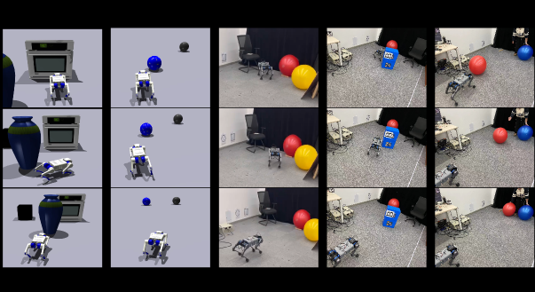
08

Slide 14
EMERGENT GAITS AND ADAPTABILITY
Gait Transfer: Without explicit training for gait changes, the model learned to adjust gaits based on instructions. Figure below shows the robot performing pronking, trotting, and pacing gaits emergently.
Interpretation: Different tasks or instruction modifiers (e.g. “fast”, “crawling”) implicitly lead QUART to select different gait parameters. This flexibility highlights the model’s ability to optimize locomotion strategy for each task without hardcoding gait controllers.
Other Emergent Behavior: The robot even performs complex behaviors like standing up or recovering from tumbles when needed (not shown) through its command outputs. These were not explicitly programmed but emerged from the learned policy’s capacity.
09

Slide 15
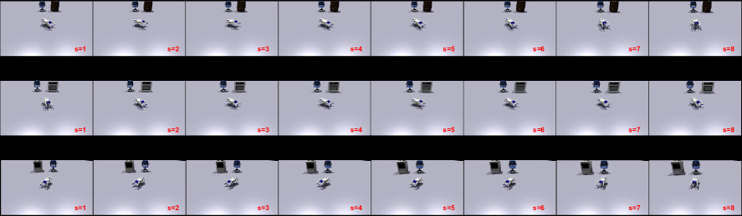
08

Slide 16
GENERALIZATION TO UNSEEN SCENARIOS
Novel Objects & Environments: QUART exhibits impressive zero-shot generalization. The robot successfully follows instructions involving unseen objects (e.g. a new backpack or letter) and in new backgrounds.
Robust Visual Reasoning: For example, a command to “go to the blue cube” succeeds even if the cube model or room layout was not in the training set. This indicates the model learned abstract visual concepts (color, shape) and could apply them flexibly.
Implications: These results demonstrate the power of the VLA approach: by learning from diverse simulated examples, the robot can handle real-world variations and new tasks without additional training.
09

Slide 17
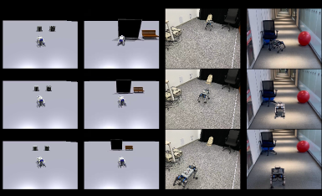
08

Slide 18


THANK YOU
تفظظلوا اسألوا ... باستثناء محمد الاطرش
ههههه لا بمزح بمزح 😅
لا بمزحش 🙃 ...
10

